Slide 1


BY

Slide 2

[Purpose]
Open Source Widget Collaboration Based on the AngularJS JavaScript Framework
Goals
Maintainable
Theme-able
No JQuery Dependencies
Lightweight Directives

Slide 3
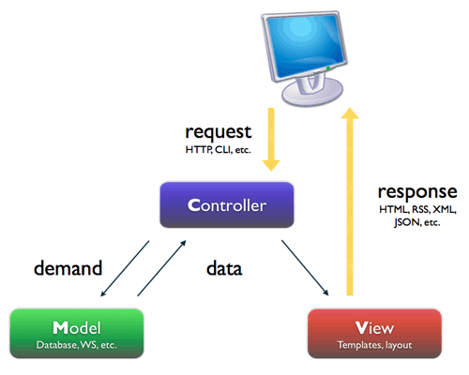
[Design]
Model View Controller
MVC
Model
BossyUI Directive
View
User Defined Template or BossyUI Default
Controller
User Defined Controller & Inherited Directive Controller

Slide 4



[Verification]
Testing
Unit Testing for basic implementation of the directive
Interactive Testing for the end-to-end testing (user interaction)
Accomplishments
Provided cogent testing to cover all use cases
Created user friendly customization of widgets
Facilitated a streamlined approach to the utilization of the BossyUI toolset with AngularJS
Helped to define the standards for future widgets in the project

Slide 5

Burn Down Charts!

Slide 6
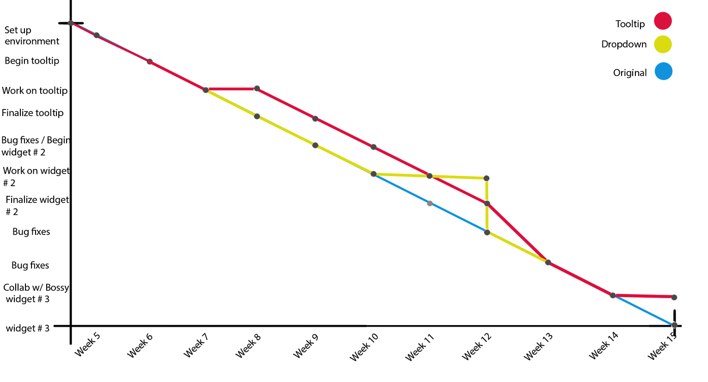

Slide 7
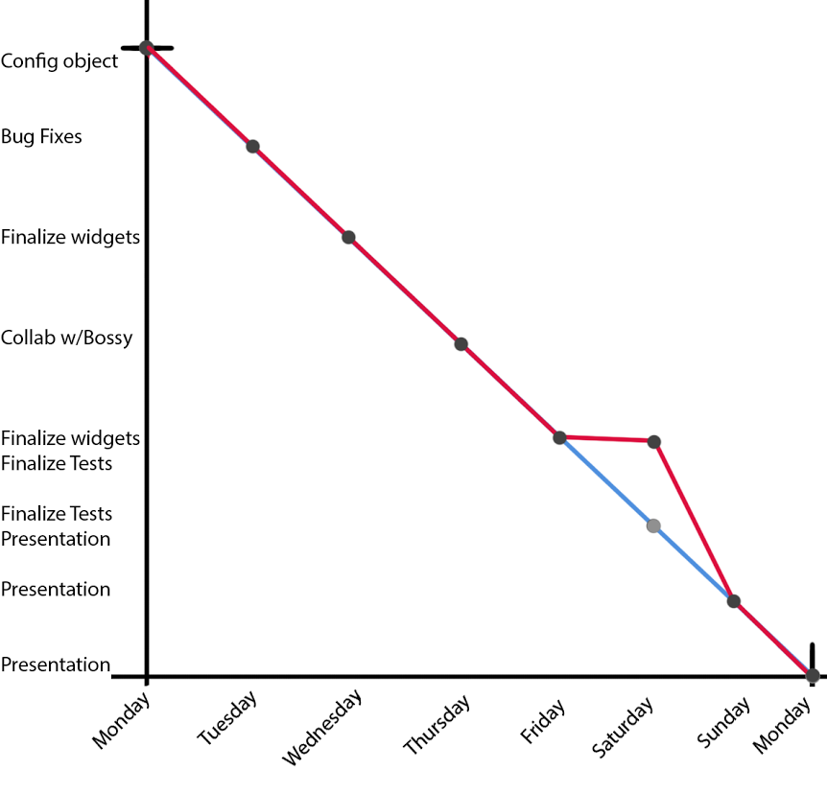

Slide 8
What We’ve Learned
Communication
Unit Testing
Collaboration on Large Project
The Power of AngularJS
Meet Design Specifications Set by Repository Owners

